Slide 1
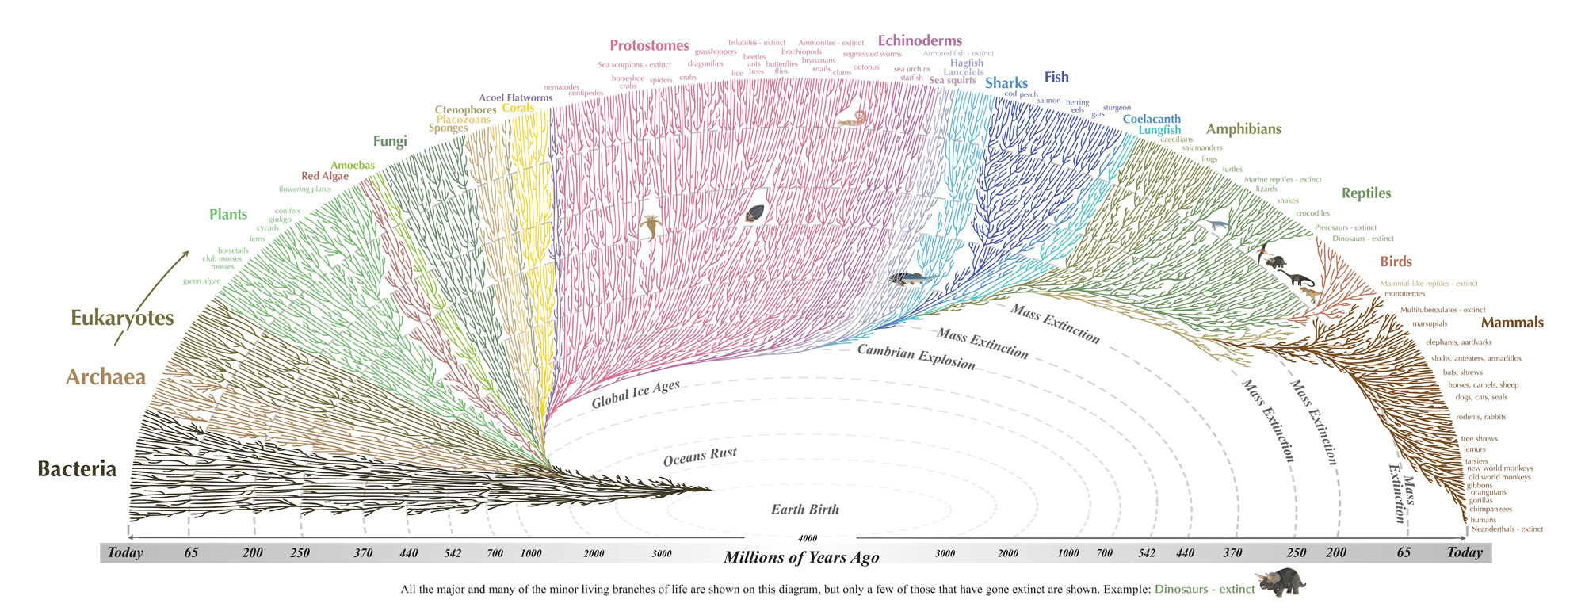
The MicrO ontology; enabling the acquisition of higher-order
knowledge of phenotypes from prokaryotic taxonomic descriptions and the construction of very large character matrices
Carrine E. Blank
University of Montana

Slide 2
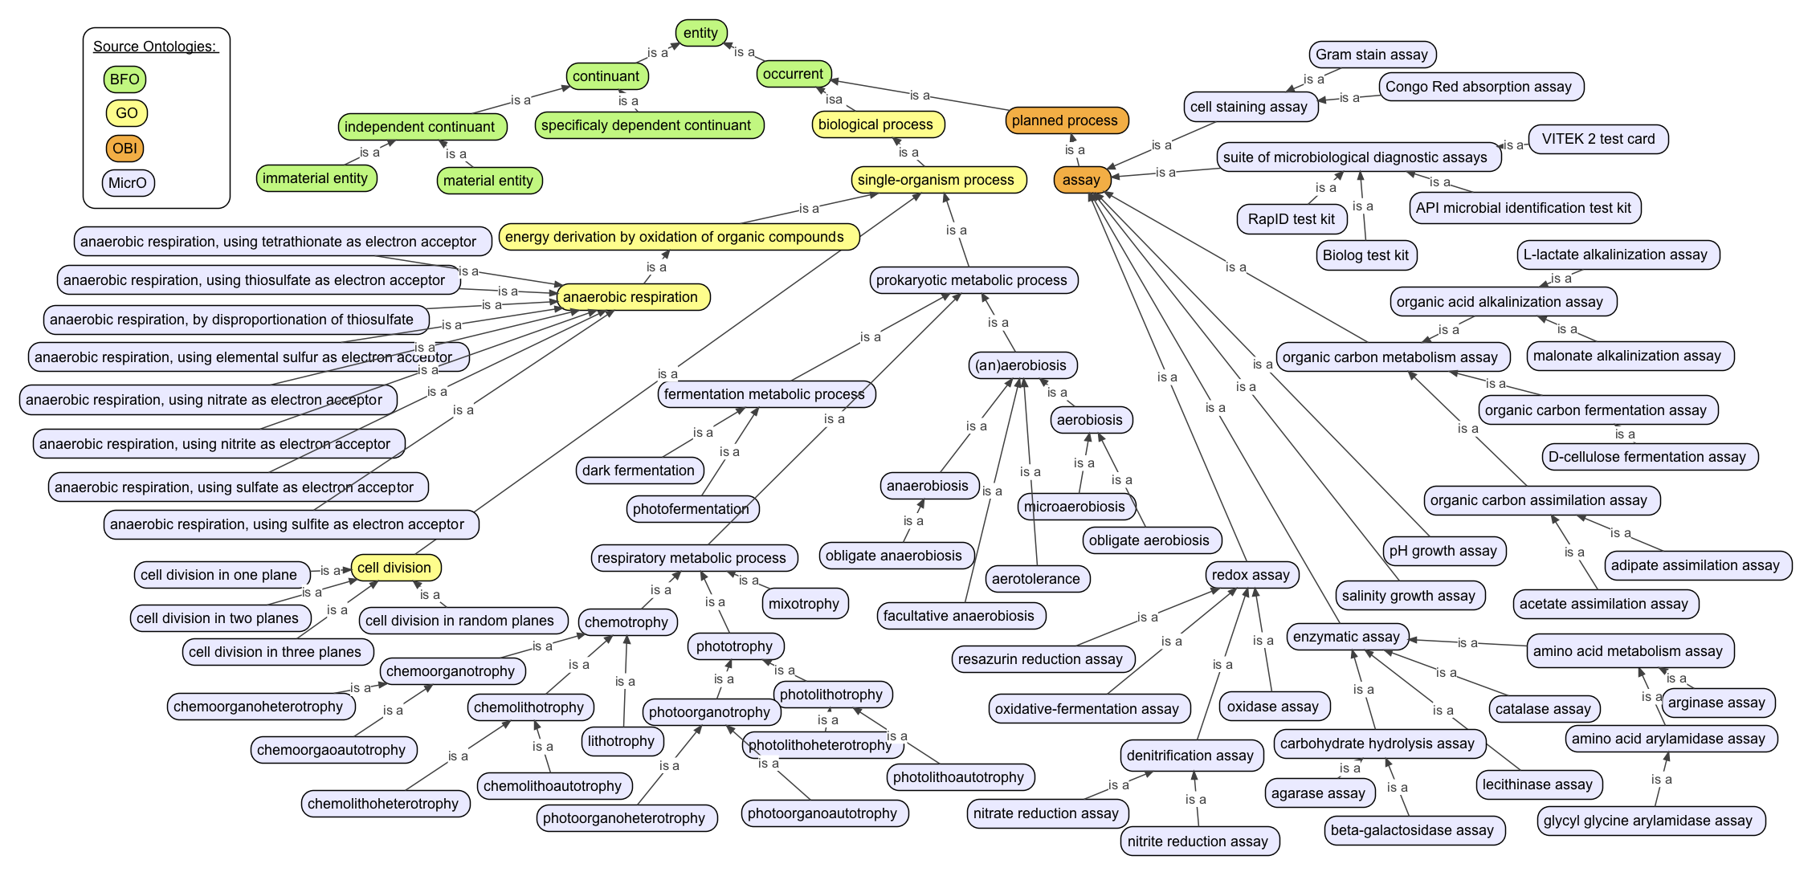
Collaborators:
Hong Cui and Jin Mao (Univ. of Arizona)
Ramona Walls (Univ. Arizona)
Lisa Moore (Univ. of Southern Maine)
Robert Thacker (Stony Brook Univ.)
Josef Uyeda (Virginia Tech.)
Luke Harmon (Univ. Idaho)
Funding:
National Science Foundation (AVAToL program)

Slide 3
Pipeline to Accelerate Study of Microbial Phenotypes
Challenge of phenotype extraction from text
MicroPIE (Microbial Phenomics Information Extractor)
MicrO (an ontology of microbial phenotypic traits found in taxonomic descriptions)
MicroPIEDigester (ontologizes phenotypes and codes characters, outputting nexus file)
Rapid acquisition of very large phenotypic character matrices to study microbial evolution.
Emerging unprecedented challenges of scale.

Slide 4
Evolution and Distribution of Phenotypes
Given phenotypes and a phylogenetic tree.
Visualize evolution of phenotypes along the tree.

Slide 5
Challenge Of Extracting Phenotypes from Text:
text is only semi-standardized:
- shape, size
- growth pH, temperature, salinity
- metabolic substrates
- physiological tests
some authors difficult to understand
many ways to state equivalent concepts
manual extraction of information extremely tedious.

Slide 6
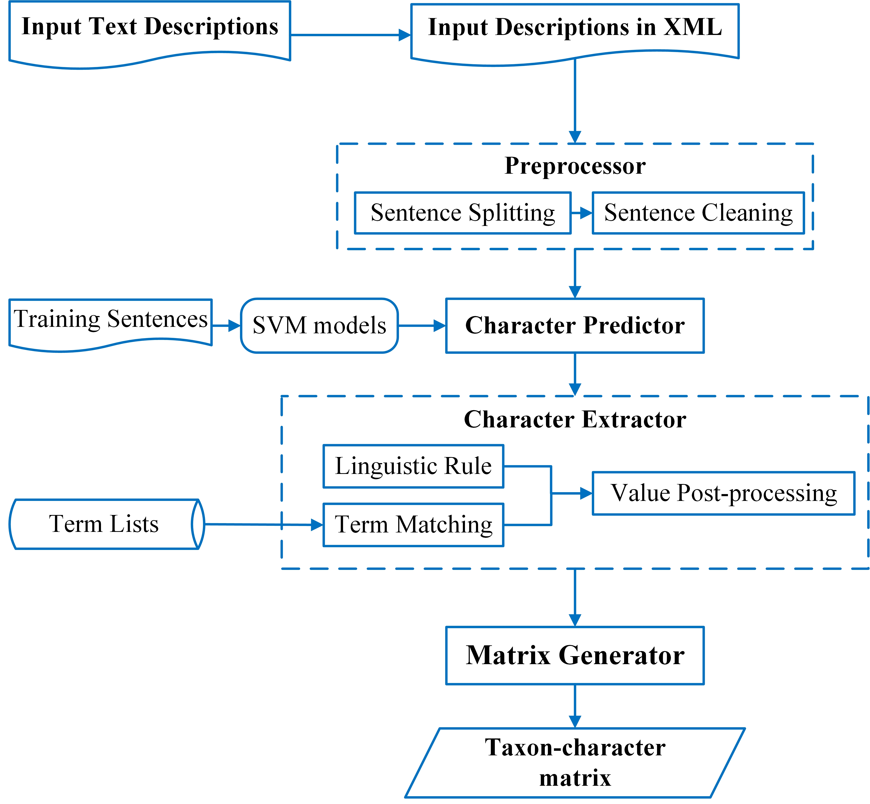
MicroPIE (Microbial Phenomics Information Extractor)
Natural language processing algorithm (Java-based, simplified web interface).
Input: Microbial taxonomic description (text, from scientific literature)
Output: A raw matrix of phrases
Phenomics: the entire collection of morphological, biochemical, and ecological traits of organisms
https://github.com/biosemantics/micropie2
Mao J, Moore LR, Blank CE, Wu EH-H, Ackerman M, Renade S, Cui H. 2016. Microbial Phenomics Information Extractor (MicroPIE): A natural language processing tool for the automated acquisition of prokaryotic phenotypic characters from text sources, BMC Bioinformatics,

Slide 7
MicroPIE (Microbial Phenomics Information Extractor)
Uses machine-learning (we provide training sentences)
Uses provided term lists to help identify the type of information in a sentence
Categorizes sentences by the type of information in the sentence.
Extracts character information and outputs into a spreadsheet/matrix.

Slide 8
Term Lists
Cell Shape:
rod
rods
short cylinders
elongated cocci
bacilli
bacillus
coccus
filamentous
vibrioid
spirillum
apical cells hyaline
appendaged
barrel-shaped
blunt clubs
waved
arcuated
branching type “T”
.
.
.
Manually constructed from >1,500 taxonomic descriptions of Archaea and Bacteria.

Slide 9
MicroPIE Character Categories:
mol % g+c
cell shape
cell diameter
cell length
cell width
cell relationships
gram stain type
internal features
motility
pigment compounds
nacl minimum
nacl optimum
nacl maximum
pH minimum
pH optimum
pH maximum
temperature minimum
temperature optimum
temperature maximum
aerophilicity
magnesium requirement for growth
vitamins and cofactors required for growth
antibiotic sensitivity
antibiotic resistance
colony shape
colony margin
colony texture
colony color
fermentation products
other metabolic product
haemolytic & haemadsorption properties
organic compounds used
organic compounds not used
inorganic substances used
inorganic substances not used
fermentation substrates used
fermentation substrates not used

Slide 10
Raw Matrix Output for MicroPIE

Slide 11
Output
Words and phrases.
See many alternative spellings.

Slide 12
MicroPIE (Microbial Phenomics Information Extractor)
Power and Potential of MicroPIE:
- Enables the rapid acquisition of phenotype data from legacy text
- Easy to use
- Open access
Ongoing Development:
- Increasing performance of text extraction
- Testing of performance
- Neural-network sequence tagging models
- Incorporation into ETC (Explorer of Taxon Concepts)
- Ontology integration

Slide 13
MicrO (A Microbial Ontology of Phenotypic and Metabolic Characters, Assays, and Culture Media Found in Prokaryotic Taxonomic Descriptions)
Constructed from term lists.
Contains ~ 2,470 terms and term definitions, thousands of term synonyms.
Constructed in OWL Protégé; following OBO Foundry principles.
Imports ~12,100 terms from 19 other ontologies, including Phenotype Quality (PATO), the Gene Ontology (GO), and Chemical Entities of Biological Interest (ChEBI).
Contains >24,300 logical axioms connecting entities and processes across multiple ontologies to facilitate inference of higher-order phenotypic traits.
Designed so modules can be re-used by other ontologies.
https://github.com/carrineblank/MicrO/
Blank CE, Cui H, Moore LR, Walls RL. 2016. MicrO: An Ontology of Phenotypic and Metabolic Characters, Assays, and Culture Media Found in Prokaryotic Taxonomic Descriptions, Journal of Biomedical Semantics 7:18.

Slide 14
Outline of MicrO Contruction
Terms grouped into candidate classes and synonyms (round, rounded, spherical, sphaerical, coccoid, coccus).
Searched for existing terms using OntoBee - imported using OntoFox.
Unique terms named as ontology classes (e.g. coccus).
Synonyms were added.
Definitions written and logical definitions created to connect to other ontologies.
Built the classes under an upper-level ontology (BFO).

Slide 15
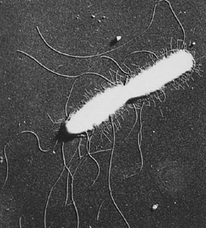
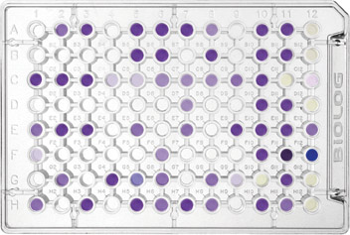
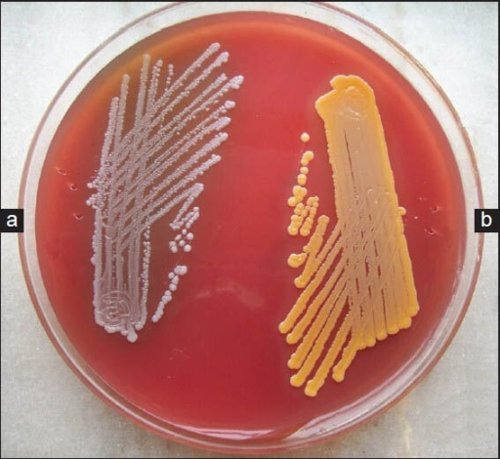
Largest Classes in MicrO
Assays (enzymatic, metabolic, and phenotypic assays)
- commercial diagnostic kits
- conventional tests performed in microbiological labs
Microbiological culture media and media ingredients
Prokaryotic qualities
-shapes, colony attributes, internal and external structures

Slide 16
classes in a hierarchical format

Slide 17
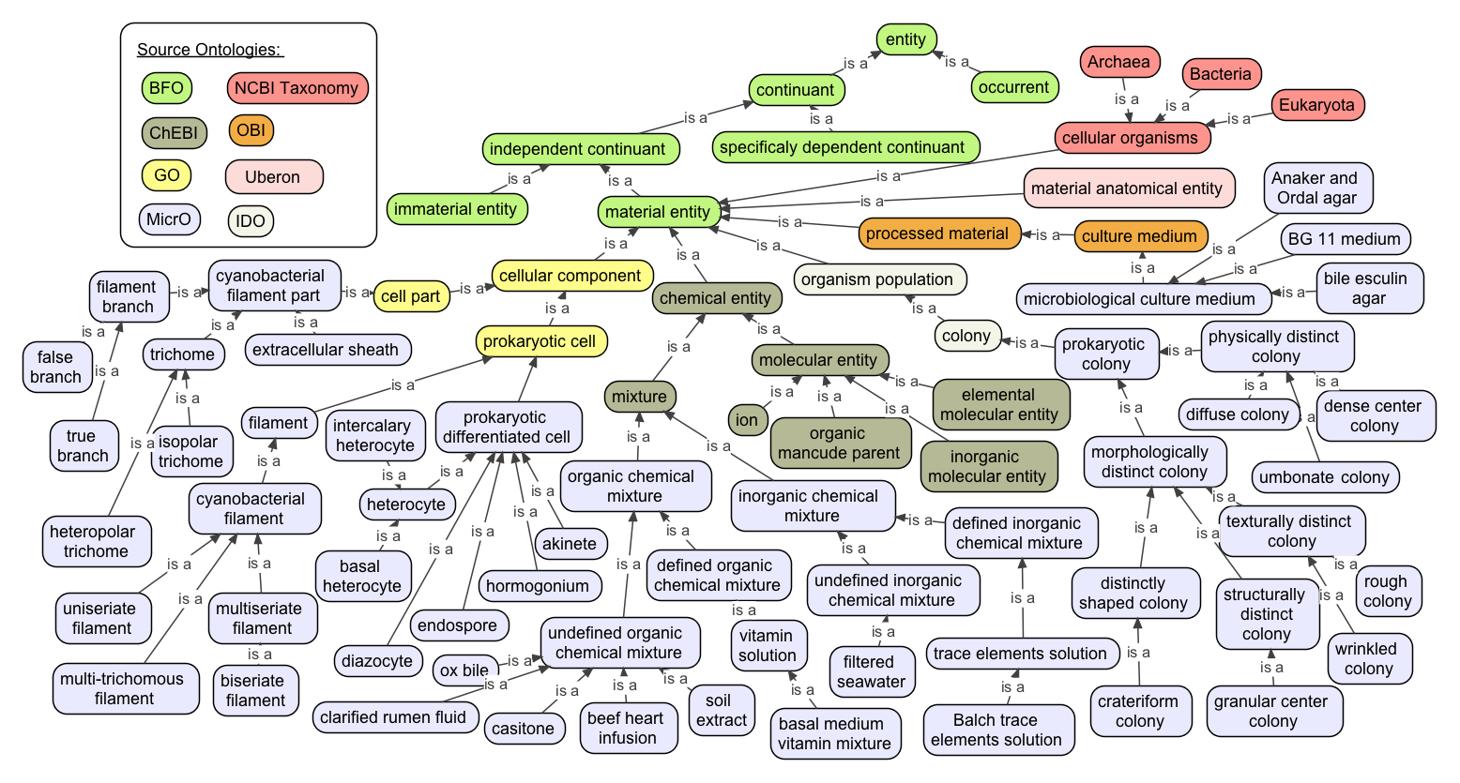
Entity Classes in Micro

Slide 18
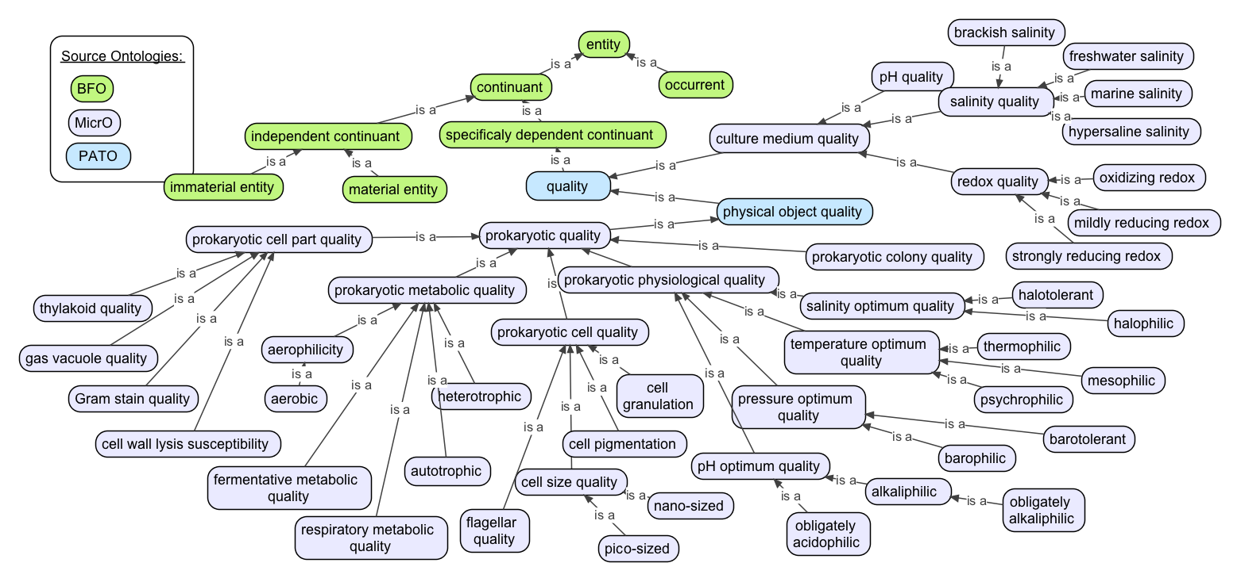
Quality Classes in Micro

Slide 19
Processes Classes in MicrO

Slide 20
class name
text definition
references
synonyms

Slide 21
Logical axioms connect the class to other classes in other ontologies

Slide 22
MicrO Classes
>750 new chemicals were added to ChEBI
(minerals, antibiotics, dyes/stains, lipids, cell wall constituents, antibiotics, and inorganic and organic metabolic substrates and products).
Prokaryotic chemical entities (~100 classes)
chemical mixtures were retained under MicrO
trace element chemical solution
vitamin solutions
complex mixtures/extracts
‘proteose peptone’
‘egg yolk oil’
‘bile salts’
‘crude oil extract’

Slide 23
MicrO Classes
Qualities (~200) to describe cell parts and shapes
flagellar qualities
Gram stain qualities
granule qualities
cell wall lysis susceptibility
metabolic qualities
chemolithoautotrophic
photofermentative
obligately aerobic
microaerophilic
aerotolerant
Cell components (~255 classes)
‘pseudopeptidoglycan-based cell wall’
‘teichoic acid-based cell wall’
‘sheath’
‘proteinaceous sheath’
‘cyanobacterial filament part’
‘multi-trichomous filament’

Slide 24
MicrO Classes
Colony qualities (~49)
colony shapes
colony structures
colony textures
logically connected to
terms in PATO

Slide 25
MicrO Classes
Microbiological medium ingredients (~140)
defined and undefined
vitamin, trace element solutions
yeast extract, peptone, corn oil extract, soil extract
heart pancreatic digest, brain heart infusion
calf serum, sea salt, homogenized chicken egg
citrated blood, laked blood, oxalated horse blood

Slide 26
Culture Media Recipes
Microbiological culture medium recipes (>910)
each logically defined by their chemical composition
logical axioms to infer:
liquid/solid medium
freshwater/brackish/marine/hypersaline
acidic/neutral/alkaline pH
strongly reducing redox/mildly reducing redox/oxidizing redox

Slide 27
Culture Media Recipes
microbiological media recipes are chemically defined, logically defined by their pH, salinity, and redox potential.

Slide 28
Assay Classes
~570 to describe microbiological diagnostic assays
OBI term ‘assay’ is the parent class
Worked with OBI-devel team to harmonize object properties and logical axiom structure in MicrO with OBI.

Slide 29
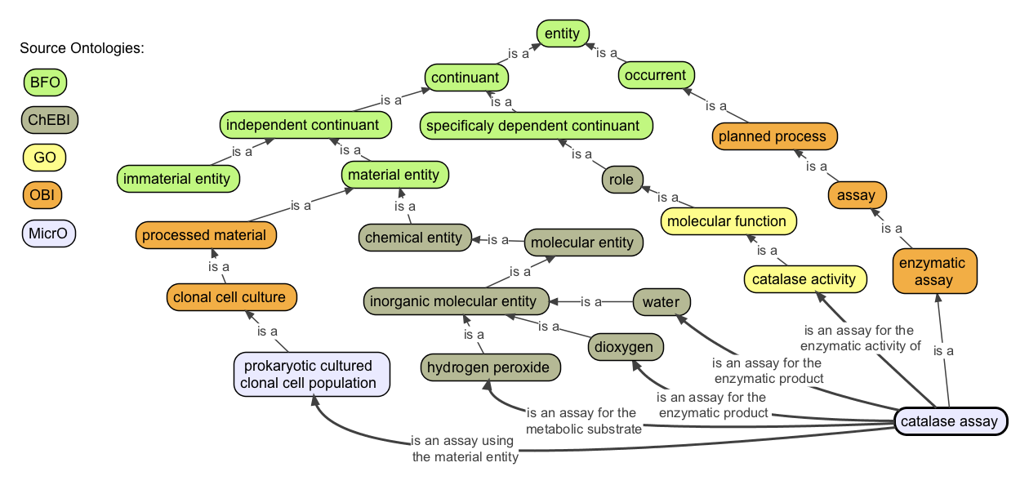
Assays logically connected to outside ontology terms
‘is an assay for the metabolic production of’ some ‘hydrogen sulfide’ (ChEBI)
‘uses culture medium’ some ‘sulfide indole motility agar’ (MicrO)
‘is an assay for the enzymatic activity of’ some ‘lactate 2-monooxygenase activity’ (GO)
‘uses enzymatic substrate’ some ‘5-bromo-4-chloro-3-indolyl beta-D-galactoside’ (ChEBI)
‘produces enzymatic product’ some 4-bromophenol (ChEBI)
‘is an assay for the biological process of’ some fermentation (GO)

Slide 30
What MicrO Doesn’t Have
Microbial habitats (MEOWL and ENVO).
Pathogenic phenotypes.

Slide 31
MicrO (A Microbial Ontology of Phenotypic and Metabolic Characters, Assays, and Culture Media Found in Prokaryotic Taxonomic Descriptions)
MicrO’s power:
controlled vocabulary for microbial terms
database of synonyms and alternative spellings
logical axioms link concepts (chemical, enzymatic, phenotypic, ecological, and process information).
extensive reuse of existing ontologies
serves as a stable knowledge resource for other informatics tools
allows new bioinformatics capabilities
open source

Slide 32
Utilize rich semantics to increase performance of MicroPIE
Sometimes taxonomic descriptions report:
a positive or negative test result (“positive for valine arylamidase”)
substrates hydrolyzed or not (“L-valine-2-naphthylamide hydrolyzed”)
The structure of the ontology, and the logical axioms will be able to connect these two as being two ways of reporting the same enzymatic trait (the presence of valine arylamidase activity).
Synonyms used to ontologize MicroPIE output
rod = bacillus = bacilli = rods = short cylinders = elongated cocci

Slide 33
Gain new knowledge from legacy text phenotypic descriptions
Given MicrO’s logical inference power.
MicrO can infer additional information not explicitly stated in the taxonomic descriptions:
- if an organism metabolizes glucose, MicrO can infer it is a heterotroph.
- if an organism grows at 89˚C, MicrO can infer it it a hyperthermophile.
- if an organism has akinetes, MicrO can infer it is in the Nostocales or Stigonematales

Slide 34
MicroPIEDigester – a Phenotype Character Matrix Generator
Simple perl script (commandline)
Input: MicroPIE spreadsheet
Output: Coded phenotypic character matrix
1. Ontologizes MicroPIE output:
rod = bacillus = bacilli = rods = short cylinders = elongated cocci
2. Codes discrete phenotypes into 0’s (absence) and 1’s (presence)
3. Outputs Mesquite-formatted nexus files.
https://github.com/carrineblank/MicroPIEDigester
Blank CE, Cui H, Mao J, Moore LR, Thacker RW, Walls RL. Accelerating the Large-Scale Study of Prokaryotic Phenotypes and Niche Space Evolution Through Time Using the MicrO Ontology, MicroPIE, and MicroPIEDigester Software, submitted to Application of Semantic Technologies in Biodiversity Science, Anne Thessen, editor

Slide 35
MicroPIEDigester automates character coding.
Inputted into Mesquite or Arbor to study character evolution.
Open access.

Slide 36
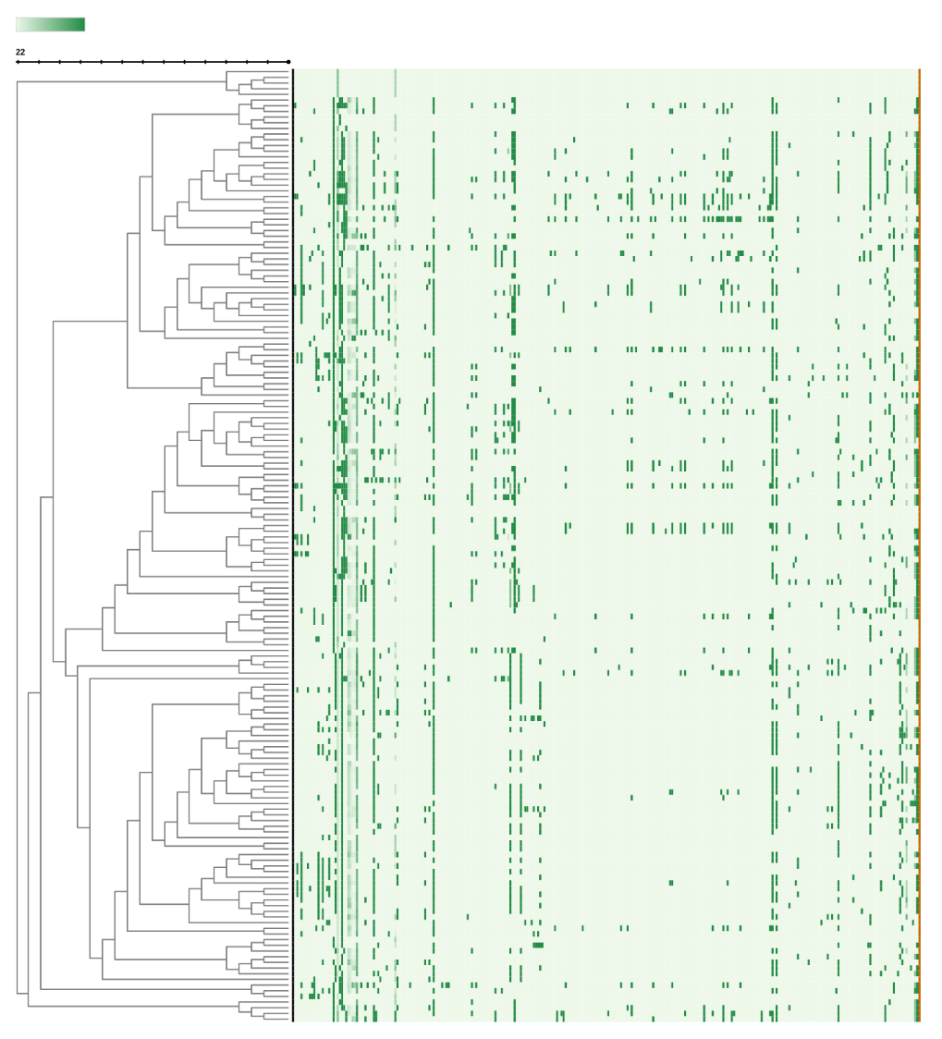
2016 Character matrix:
189 taxa (rows in matrix)
371 discrete characters
12 continuous characters
- mol% G+C
- temp min/opt/max
- salinity min/opt/max
- pH min/opt/max
- cell width/length

Slide 37
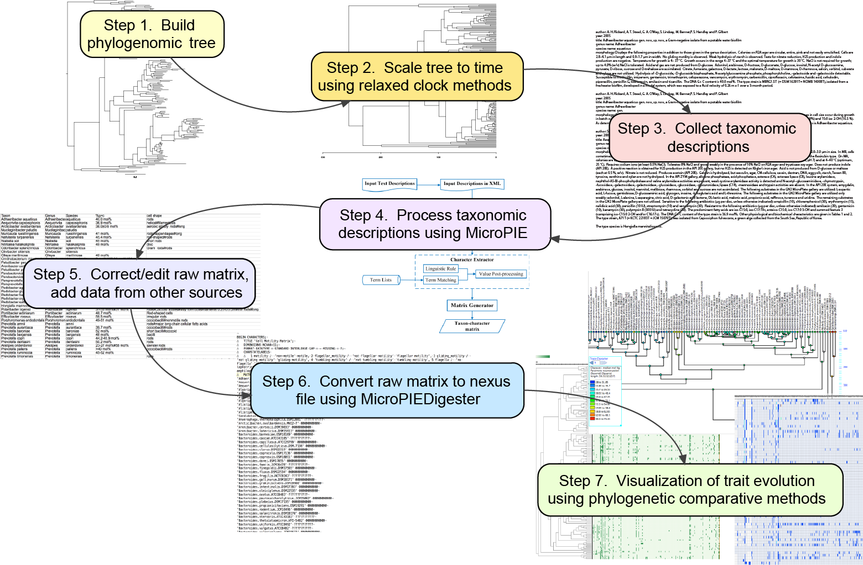
Data Analysis Pipeline Provides New Capabilities
Blank CE, Cui H, Mao J, Moore LR, Thacker RW, Walls RL. Accelerating the Large-Scale Study of Prokaryotic Phenotypes and Niche Space Evolution Through Time Using the MicrO Ontology, MicroPIE, and MicroPIEDigester Software, submitted to Application of Semantic Technologies in Biodiversity Science, Anne Thessen, editor

Slide 38
New Data Analysis Pipeline Provides New Capabilities
Accelerates character evolution studies
Facilitates fundamental new insights in:
- microbial evolution, pathogenesis
- microbial diversity, niche preferences
- climate change
- changing influence on biogeochemical cycles
Provides new tools for:
- paleontologists
- microbial systematists
- guidance for effective ways to describe taxa
- objective ways to define groups (families, orders)
Blank CE, Cui H, Mao J, Moore LR, Thacker RW, Walls RL. Accelerating the Large-Scale Study of Prokaryotic Phenotypes and Niche Space Evolution Through Time Using the MicrO Ontology, MicroPIE, and MicroPIEDigester Software, submitted to Application of Semantic Technologies in Biodiversity Science, Anne Thessen, editor
59/60

