Slide 1

Hidden Microbiome of Infection Surveillance Culture Program and the Living µBiome Bank
Alexander V. Alekseyenko^{1,2} and Jihad Obeid²
¹Program for Human Microbiome Research
²The Biomedical Informatics Center (BMIC)
Medical University of South Carolina

Slide 2
MUSC Hospital Active Infection Surveillance culture program
Every inpatient admitted to the hospital is subject to the program
Swabs for MRSA and VRE are obtained as soon as possible after admission
Samples are processed within 24-48 hours to determine colonization
BD auto-streaking instrument is used to minimize bias
75% of the specimen volume remains in excess and is discarded within a week of collection

Slide 3
Number of specimens processed by MUSC Diagnostic Microbiology Lab (DML) in a typical month
N/month | Specimen description
2,584 | Urine in BD preservation tubes* or sterile containers
2,472 | MRSA surveillance Eswabs**
2,379 | VRE surveillance Eswabs**
501 | Wound Eswabs**
364 | Lower respiratory specimens in sterile containers
170 | Vaginal/rectal Eswabs** for Group B Streptococcus
160 | Stool submitted for C. difficile PCR in sterile containers
147 | Stool submitted for G.I. PCR Panel in sterile containers
105 | Tissues, frozen at -70C for 1-2 months
52 | Sterile body fluids

Slide 4
Vision: The surplus materials from active infection surveillance program will be used for translational research at MUSC

Slide 5
Why focus on infection surveillance culture program specimens?
Sampling uniformity
Only a few trained nurses are assigned to collect the swabs, minimizing the collection bias.
Sample handling is automated, minimizing handling bias.
Participation reach
All subjects are subject to the program.
MRSA swabs are collected from almost every subject.
VRE swabs collected from select units (surgery, etc.)
Impact potential
Specimens are collected early in the course of providing care.
Specimens are collected throughout care provision timeline.

Slide 6
Preliminary Living µBiome Bank Workflow

Slide 7
Preliminary RDW schema for microbiome

Slide 8
Immediate Goals
Goal 1: Determine the suitability of surplus surveillance testing material for microbiome analysis.
Goal 2: Determine feasibility of obtaining the excess specimens from DML in a de-identified way.
Goal 3: Establish the infrastructure for storage of massive amounts of patient microbiome data in RDW.
Goal 4: Perform proof of principle pilot research studies on these specimens.
Goal 5: Provide a system for ordering de-identified microbiome specimens from precisely defined patient cohorts within and outside MUSC.
Goal 6: Determine the utility of microbiome biomarkers in predicting patient visit health outcomes.

Slide 9
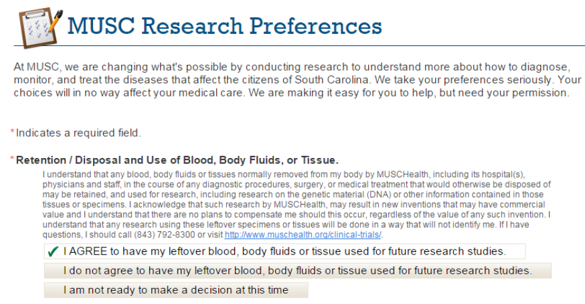
Consent challenges
We will use research preferences collected routinely in EHR
Patients are invited either via Patient Portal or during encounter
However there are limitations…

Slide 10
Research Preferences

Slide 11
Consent challenges (continued)
Less than 15% of patients have answered the MUSC Research Preferences questionnaire
We will exclude those who do not agree to have their leftover specimens for future research studies
What about the other 85% of patients who have not answered the questionnaire?

Slide 12
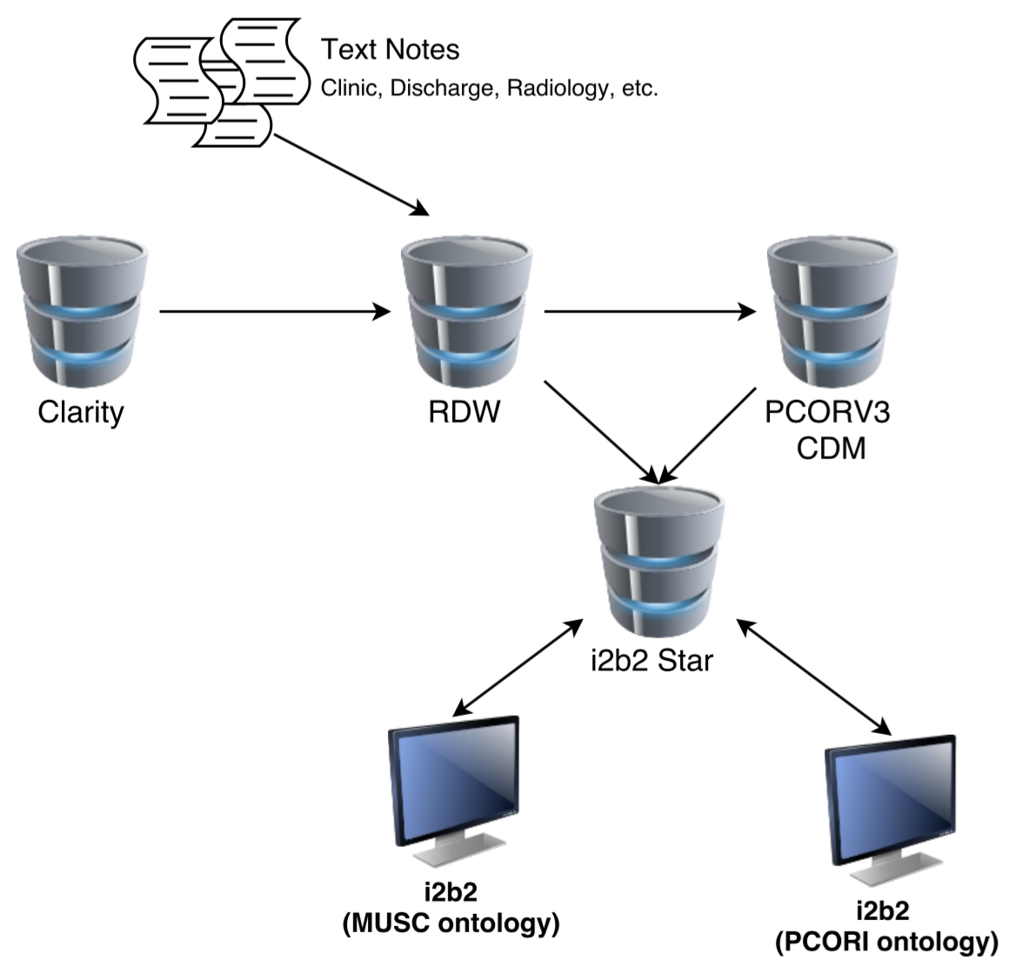
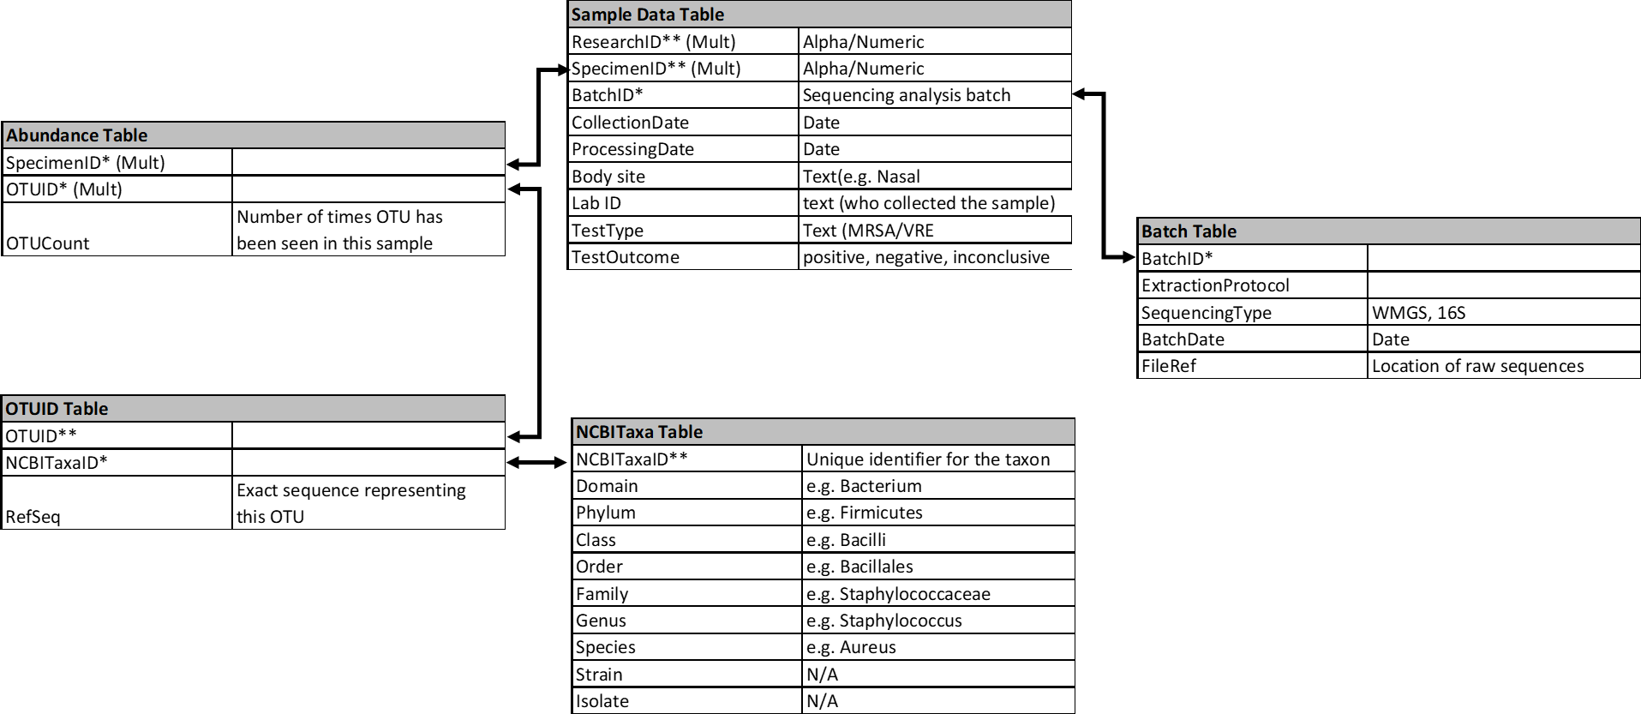
Research Data Warehouse
Epic
Includes:
Cancer Registry
Research permissions
Microbiome data (linked using research ID)

Slide 13
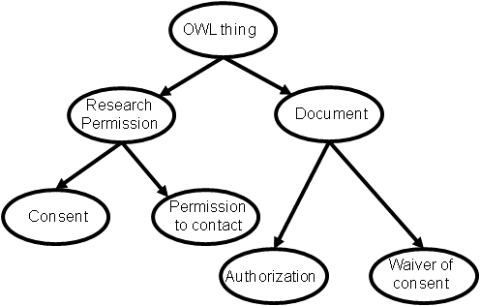
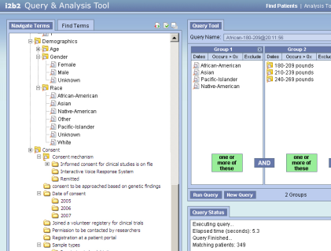
Microbiome data repository (in RDW and beyond)
RDW
OHMI
(DOID)
OBIB
Data Sharing & Analysis
Query ontology
Microbiome data
i2b2 Workbench

Slide 14
Acknowledgments
Leslie Lenert, Chief Research Information Officer
Cassy Salgado, Director Infectious Diseases
Lisa Steed, Director Microbiology Diagnostic Lab
Bashir Hamidi, Statistical Analyst & IRB specialist
Katharine Patterson, MSHI Capstone Student
Grant #s: The project described was supported in part by the NIH National Center for Advancing Translational Sciences (NCATS) through Grant Number UL1TR001450
and MUSC College of Medicine Enhancing Team Science (COMETS) award to AVA.

