Slide 1
EuPath Ontology: Supporting Resources for Infectious Disease Research
Chris Stoeckert, Ph.D.
Jie Zheng, Ph.D.
Microbiology for the CTSA: Ontological Approaches
CTSOG 2017 Ann Arbor, MI

Slide 2
Eukaryotic Pathogen Bioinformatic Resource Center
NIAID supported center to provide public resources to explore and mine datasets on eukaryotic pathogens and host interactions
Include major disease causing pathogens such as Plasmodiums, Trypanosomes, and fungal pathogens.
236 annotated genomes
Omics datasets
Epidemiologic datasets

Slide 3
Fourteen EuPath-supported Resources
A systems biology platform for integrating, mining and analyzing microbiome datasets
Ten organism-centered web sites plus a EuPath portal and ortholog site
Coming soon with initial datasets on malaria surveillance and enteric pathogens
Focus is on people and how their environment impacts disease
Notes:
high level of what each resource provides

Slide 4
Purpose of the EuPath ontology
The EuPath ontology is an application ontology developed to encode our understanding of what data is about in the public resources developed and maintained by the Eukaryotic Pathogen Database Bioinformatics Resource Center (EuPathDB; http://eupathdb.org).
The EuPath ontology was built based on the Ontology of Biomedical Investigations (OBI) with integration of other OBO ontologies such as PATO, OGMS, DO, etc. as needed for coverage.
Currently the EuPath ontology is primarily intended to be used for support of the EuPathDB sites. Terms with EuPath ontology IDs that are not specific to EuPathDB will be submitted to OBO Foundry ontologies for subsequent import and replacement of those terms when they are available.
https://bioportal.bioontology.org/ontologies/EUPATH

Slide 5
What goes into EuPath ontology
We have to load, integrate, and make available for data mining a new data set with rich descriptions of specimens or has many epidemiological variables.
Data and variables need to be understood and need to be semantically consistent with previous (and future) datasets.
Once data is displayed on a web site in user-friendly (as opposed to ontology-rigorous) form, it still needs to be understood through the ontology.

Slide 6
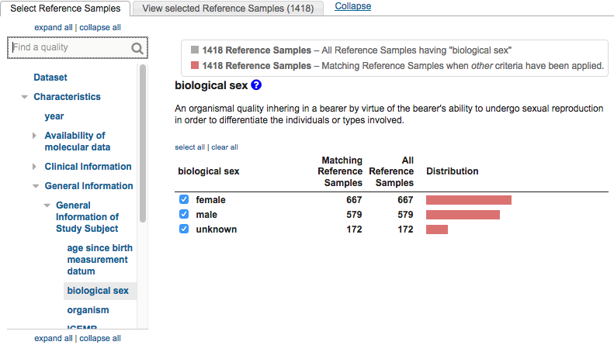
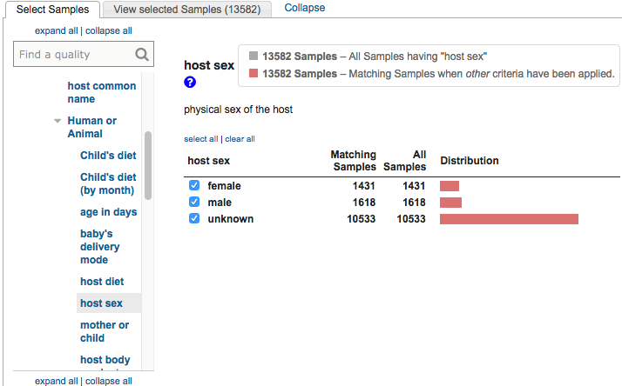
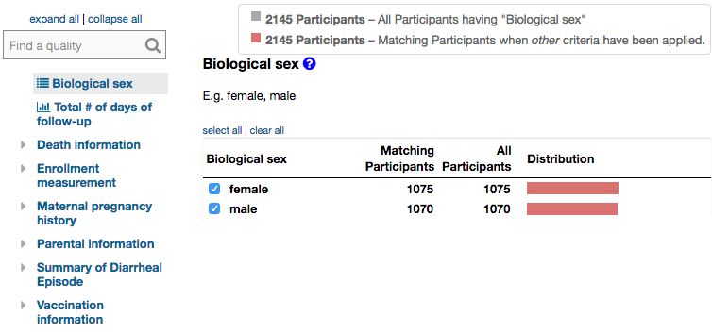
When are we referring to the same things on different sites?
From EuPath: Identify Genes based on ICEMR Serum Antibody Levels
From MicrobiomeDB: Identify Samples based on Sample Details
From ClinEpi: Select a Set of Participants

Slide 7
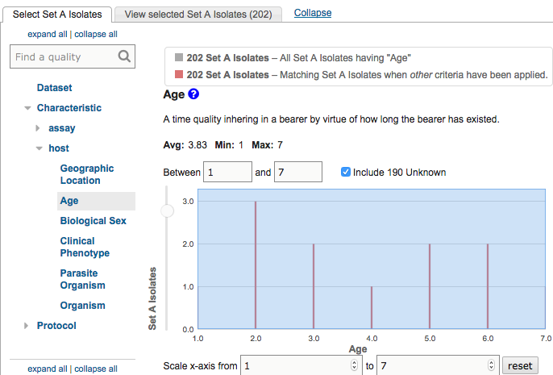
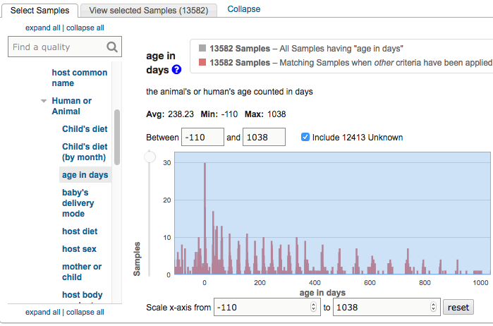
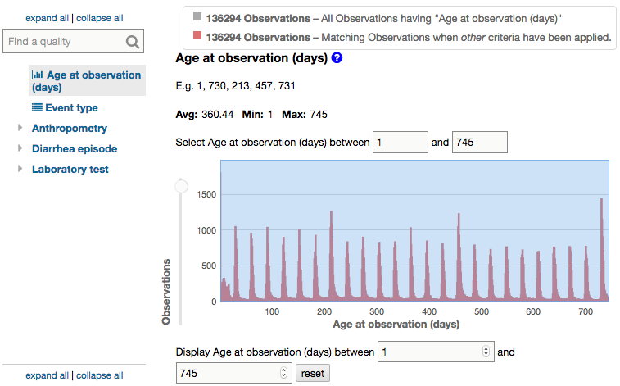
When are we referring to the same things on different sites?
From EuPath: Identify SNPs based on Differences Between Two Groups of Isolates
From MicrobiomeDB: Identify Samples based on Sample Details
From ClinEpi: Select a Set of Participants

Slide 8
Extract column headers from data files (variables)
The EuPathDB Ontology helps us: - Encode understanding of variables - Track when variables from different projects are about the same entity - Provide semantic harmonization across projects for web sites.
Compare to EuPath ontology
Look for in OBO ontologies
Use previous associated web display
Jie Zheng
Cristian Cocos
Submit to OBO ontology
Add to EuPath ontology
Notes:
How we strive to be consistent across projects

Slide 9
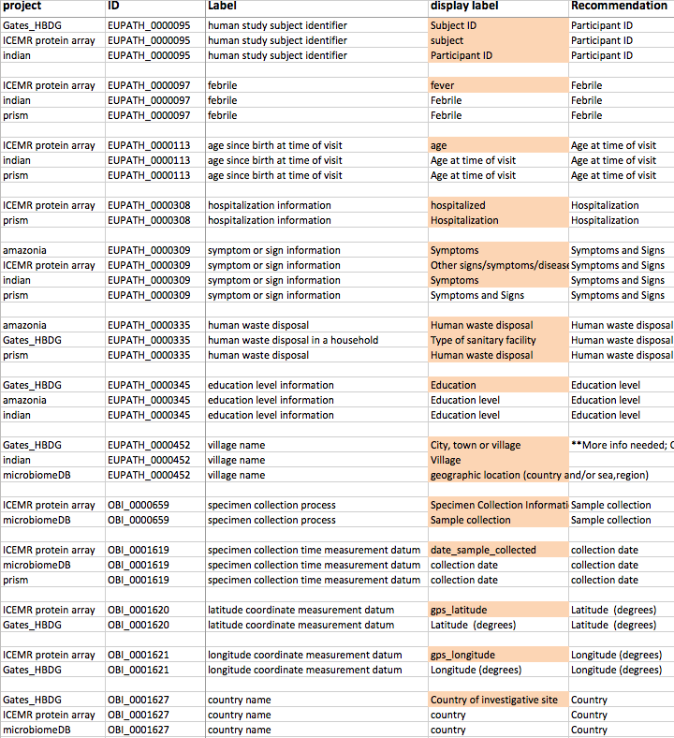
Achieving semantic harmony across projects and sites
Gates_HBDG => ClinEpi
ICEMR protein array => EuPathDB
amazonia (ICEMR) => Clin
indian (ICEMR) => ClinEpi
prism (ICEMR) => ClinEpi
microbiomeDB => MicrobiomeDB
ICEMR = International Center of Excellence in Malaria Research

Slide 10
A deep dive into the EuPath ontology
What is in the ontology
choices in modeling
pre- versus post-compositional classes to meet project needs
target ontology for new terms (where can IDO help?)

Slide 11
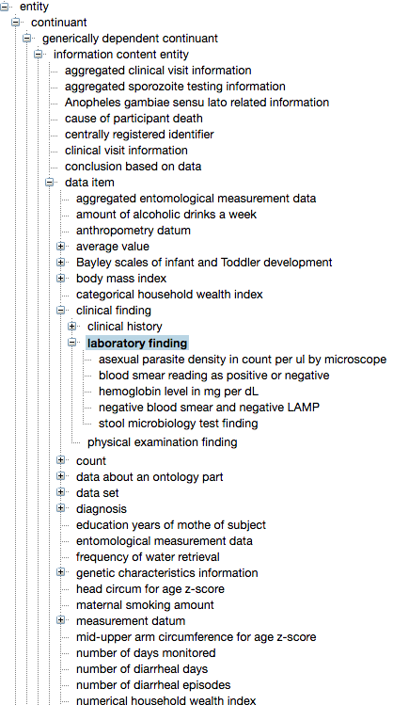
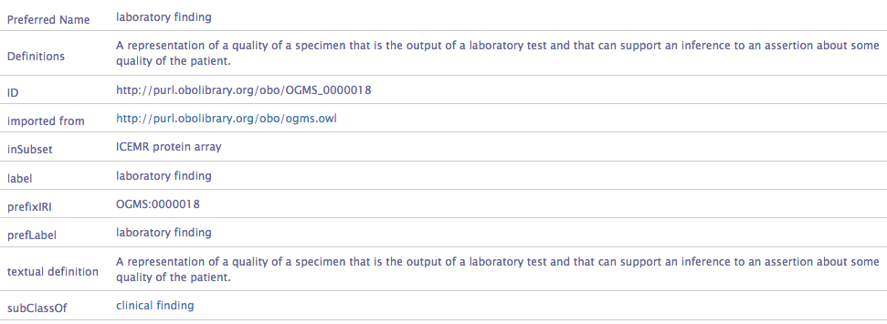
The EuPath Ontology: Information content entities
Notes:
Use other screen shots like this to highlight pre versus post-comp and target ontology issues.

Slide 12
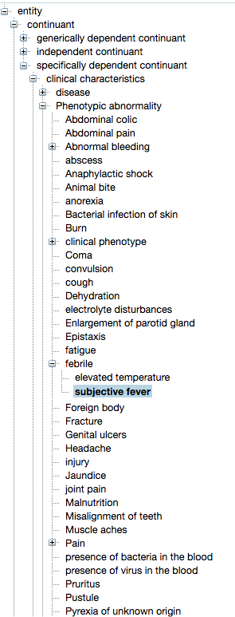
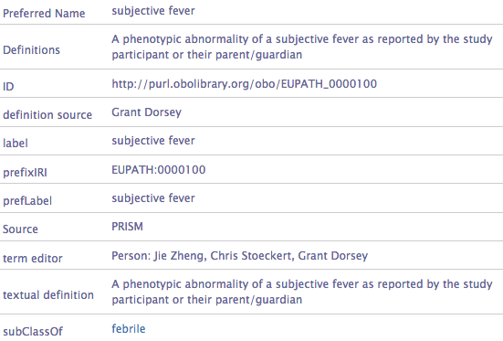
The EuPath Ontology: Phenotypic abnormality
Notes:
Use other screen shots like this to highlight pre versus post-comp and target ontology issues.

Slide 13
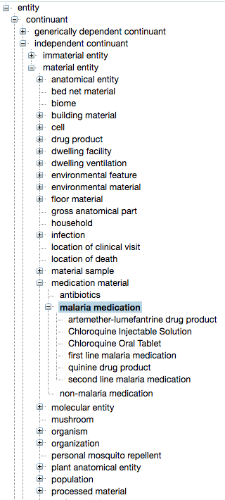
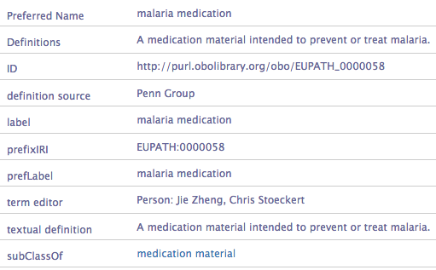
The EuPath Ontology: Material entity
Notes:
Use other screen shots like this to highlight pre versus post-comp and target ontology issues.

Slide 14
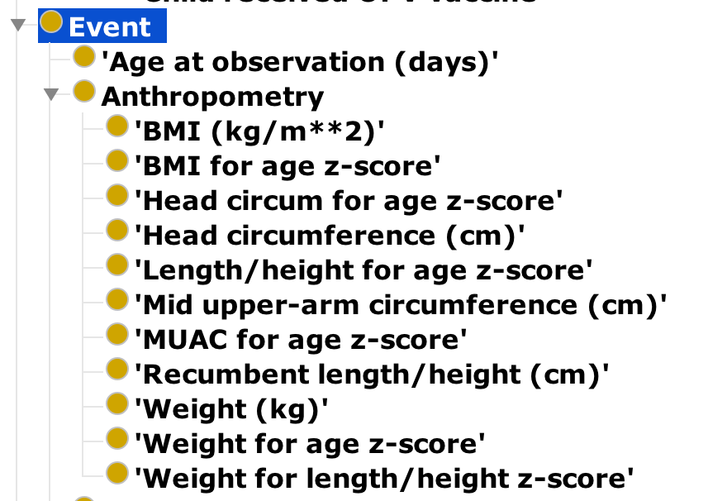
Post-composition
Longitudinal study
Based on selected age at observation to view anthropometry measured at that time/time period

Slide 15
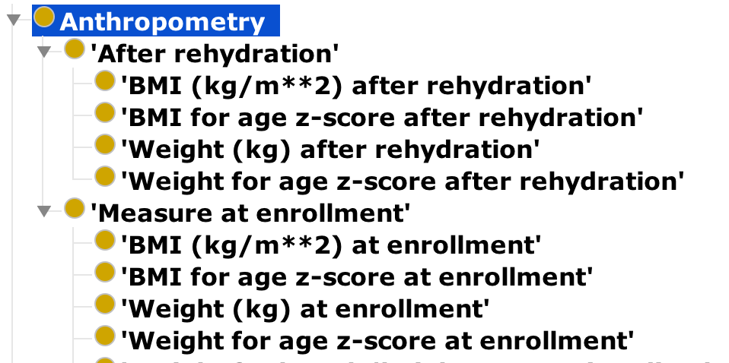
Pre-composition
Case-control study
Compare case anthropometry measurement at enrollment and after rehydration treatment

Slide 16
Examples of Submitted Terms
ENVO: ‘river water’
OBIB: ‘information on availability of parasite genetics data’
OHMI: ‘stool microbiology test finding’
OMRSE: ‘human traveling information’
IDO?
‘antibiotic administration’
‘Date of first antibiotic administration’
‘Were rectal swabs collected before antibiotics, and was a whole stool collected within 12 hrs. of registration?’

Slide 17
EuPath ontology questions
What should we be submitting to IDO?
Where do we draw the line between submitting to other ontologies and generating our own?
The IRIs in EuPath ontology are fake since it is primarily meant for internal purposes! Should we register it in OBO Foundry?

Slide 18
Thank you
EuPath team
David Roos (PI)
Jessie Kissinger (Co-PI UGA)
Chris Stoeckert (Co-I)
Christiane Hertz-Fowler (WT PI Liverpool)
Cristina Aurrecoechea
Ana Barreto
Eve Basenko
Bob Belnap
Austin Billings
John Brestelli
Brian Brunk
Shon Cade
Danielle Callen
Cristian Cocos
Katherine Crouch
Ryan Doherty
Dave Falke
Steve Fischer
Bindu Gajria
Omar Harb
Mark Heiges
Sufen Hu
Jay Humphrey
John Iodice
Cris Lawrence
Wei Li
Brianna Lindsay
Debbie Pinney
Jane Pullman
Achuchuthan Shanmugasundram
Drew Spruill
David Starns
Haiming Wang
Susanne Warrenfeltz
Jie Zheng
MicrobiomeDB
Dan Beiting (PI)
Gabriel Fernandes (Co-I Belo)
Francislon Oliveira
EuPath Team
Notes:
PRISM, Gates

